Slide 1
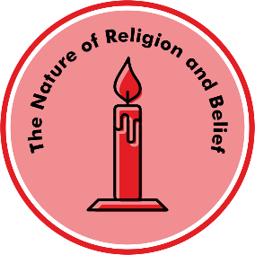
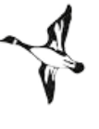
Unit E.2 Why are some objects special?
Prior learning
In nursery and pre-school settings, children will have begun to make sense of their own life story and family history. They will have been developing positive attitudes about the differences between people.
Children will be able to talk about what they see, extending their vocabulary. They will have taken part in simple pretend play, using an object to represent something even though they are not similar.
Key Learning
Families are all different but can be similar in some ways.
Objects can be precious because of where they came from, who gave them to us or how they make us feel.
We need to treat special objects with care and respect.
Jewish people often have a mezuzah on their door at home. They touch the mezuzah to remind them of God.
The Torah is a special book for Jewish people. The scroll is written in the language of Hebrew and wrapped in a cover.
Christians have special objects like a cross, candle and beads that help them think about Jesus. The bible is their holy book.
The Muslim holy book is the Qur'an. It is about Allah and his followers. It is kept on a high shelf and handled very carefully.
Hindus families worship at home using a puja tray to offer light, incense, flowers and food.
Key Questions
What makes a home?
Which objects are special to me?
What artefacts and books are special to Jewish people?
What artefacts and books are special to Christians?
What artefacts and books are special to Muslims?
What artefacts are special to Hindu families?
Key vocabulary
different, similar, precious, respect, family tree, Jewish people, Torah, mezuzah, Christian, Bible, Jesus, Muslim, Qur'an, Allah, Hindu, puja tray, shrine
Transferable Question
What do I think a religion is?
Knowledge Organiser for Believing and Belonging © Pennine Learning Associates Ltd

