Slide 1
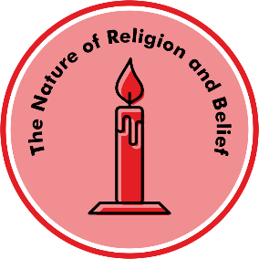

Unit E.1 Which places are special to members of our community?
Prior learning
In nursery and pre-school settings, children will have begun to make sense of their own life story and family history.
They will have been developing positive attitudes about the differences between people.
Children will be able to talk about what they see, extending their vocabulary.
Key Learning
Special places can make people feel excited or calm.
Special places can be outside in nature or in a building. People can go there alone or with their family / friends.
People of different religions go to places of worship to pray or give thanks.
A church is a special place for Christians.
A mosque is a special place for Muslims.
A mandir is a special place for Hindus.
A gurdwara is a special place for Sikhs.
Different places of worship have some things the same such as special symbols, windows, towers or domes.
Special places can have special objects inside like books, patterns and statues.
Key Questions
What makes a place special?
Where are special places for me at home, school or in my community?
Which places are special for Christians? Why?
Which places are special for Muslims? Why?
Which places are special for Hindus? Why?
Which places are special for Sikhs? Why?
How are special places the same or different?
Key vocabulary
Special, community, worship, holy,
Christian, Muslim, Sikh, Hindu
Church, Mosque, Gurdwara, Mandir
Other vocabulary: Bible, Qur'an, Allah, Guru Granth Sahib, Langar
Transferable Question
What do think a religion is?
Knowledge Organiser for Believing and Belonging © Pennine Learning Associates Ltd

