Slide 1
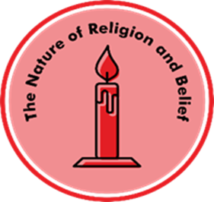

Unit C1.1 Why do people choose to belong to a community of belief?
Key Learning
Many people belong to a range of different groups such as their family, school or team
Special places are locations that hold particular significance for people
Places of worship have many different features and artefacts
Some people belong to a faith community. A faith community is a group of people who believe the same things as each other about God or the religion they follow
Religion often provides a strong sense of community, a ready-made group with shared beliefs, dress, actions and traditions
There are many ways in which people express their identity and belonging within faith communities
Prior learning - Early learning Goals
Know some similarities and differences between different religious and cultural communities in this country drawing on their experiences and what has been read in class.
Key Questions
What symbols and signs show belonging?
What makes a place special?
How do Christians show they belong to a church?
What might you see inside a church?
How do Muslims prepare themselves for worship and prayer?
What might you see inside a mosque?
What does it mean to belong to a synagogue?
Why do people choose to belong to a community of belief?
Key vocabulary
belong, symbol, faith, community, place of worship, special, Christian, church, together, worshippers, church, artefacts, Muslims, mosque, wudu, dome, minaret, quibla wall, Torah, synagogue, jews, traditions
Transferable Question:
What do you think is important to religious people?
How do people show they belong?
Knowledge Organiser for Believing and Belonging © Pennine Learning Associates Ltd

